Slide 1


Department of Computer Science and Engineering
GE19621 PROFESSIONAL READINESS FOR
INNOVATION, EMPLOYABILITY AND
ENREPRENEURSHIP
AI-POWERED NUTRITION ANALYZER FOR FITNESS ENTHUSIASTS
Devanathan A
210701050
Ganesh P 210701059
Dr.T.Kumaragurubaran., M.Tech., Ph.D AP(SG).,
Professor

Slide 2
Abstract
This project develops an AI-powered nutrition analyzer for fitness enthusiasts, providing personalized dietary guidance. It uses machine learning for diet assessment, natural language processing for user inputs, and a robust nutritional database. The system recognizes food items from images, offering real-time, nutrition content. It adapts to users' evolving needs by learning from their data and feedback, supporting goals like maintaining the calories and diet.. Initial trials show increased user satisfaction and improved fitness metrics, showcasing AI's potential to revolutionize personal nutrition management.

Slide 3
Existing System
The existing nutrition analyzer struggles with managing complex, large volumes of nutriton data and making timely, accurate decisions. Manual processes often lead to errors and incorrect insights. The fruit and food classification primarily rely on manual data entry and barcode scanning to track nutritional content. Users typically log their meals by searching for food items in a database or scanning product barcodes. This manual process can be less efficient and less accurate, making it harder for users to maintain and manage their diets effectively. Additionally, these systems often lack real-time feedback and adaptation based on individual user habits and evolving nutritional needs, limiting their effectiveness in providing personalized dietary guidance.

Slide 4
Proposed System
The proposed system revolutionizes to building a model which is used for classifying the fruit depends on the different characteristics like color, shape, texture etc. Here the user can capture the images of different fruits and then the image will be sent the trained model. The model analyses the image and detect the nutrition based on the fruits like (Sugar, Fiber, Protein, Calories, etc.). This project is very helpful to People. Everyone Maintaining their own diet, to manage the time. By using this system, the users can predict and analyze the picture of the fruits and foods. In which it results to the visualizing the description of the foods taken as input.

Slide 5
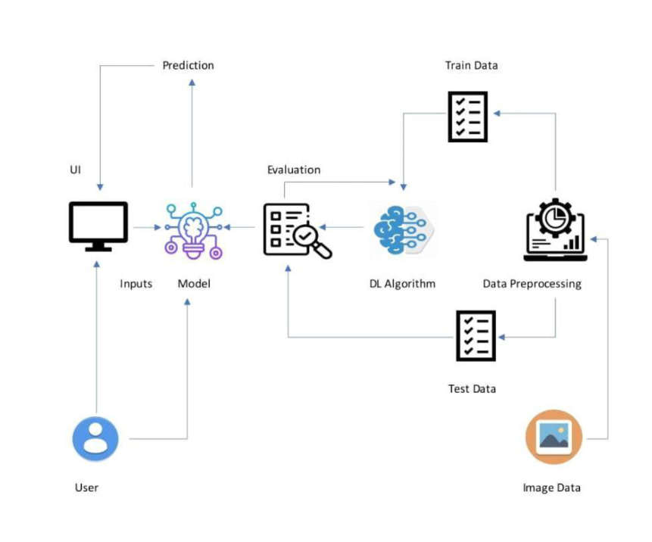
System Architecture

Slide 6
List of Modules
Creation of Dataset
Creating Prediction and Analysis using Machine Learning model
Connecting the Front-end and Back-end with API’s
Implementation and result of Modules

Slide 7
Functional Description for each modules
Creation of Dataset: Creating nutrition dataset involves defining objectives, collecting data from various sources, cleaning it by removing duplicates and handling missing values, and standardizing formats. The data is then integrated and transformed, ensuring consistency. Finally, feature engineering is performed to create new, useful variables for analysis and predictive modeling.

Slide 8
Functional Description of Module
Creating Prediction and Analysis Machine Learning model: After creating the nutrition database through the dataset it is important to create model for prediction and analysis. The analysis model was created for different parameters like Sugar, Fiber, Protein, Calories, etc.Also the prediction for the nutrition success rate was also produced and analyzed very carefully. Hence by this way creating prediction and analysis was done.

Slide 9
Functional Description of Module
Connecting the Front-end and Back-end with API’s: APIs act as a bridge between the user-facing frontend (buttons, input) and the data-driven backend (dataset). They allow the frontend to request and receive data from the backend, enabling a smooth flow of information and actions within your application. This separation of concerns promotes cleaner code, easier maintenance, and a more scalable architecture.

Slide 10
Functional Description of Module
Implementation and result: The result of developing the fitness website, utilizing HTML, CSS, Javascript and Python and user-centric platform that effectively meets its intended goals and enhances user engagement in health and fitness management. The website provides comprehensive features including nutrition tracking . Its ability is to learn from user interactions allows it to continuously improve responses and adapt to user preferences over time.

Slide 11
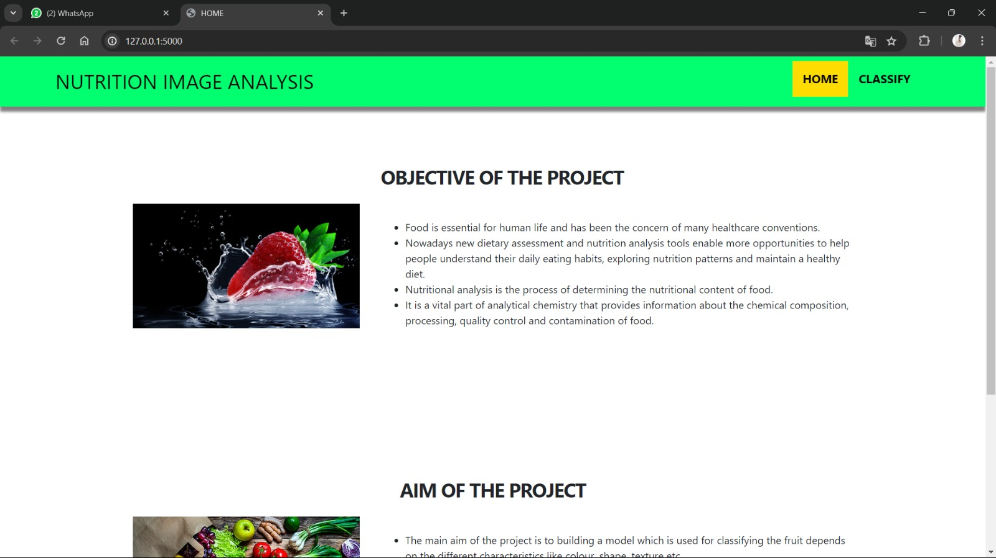
Output
Initial page of the application

Slide 12
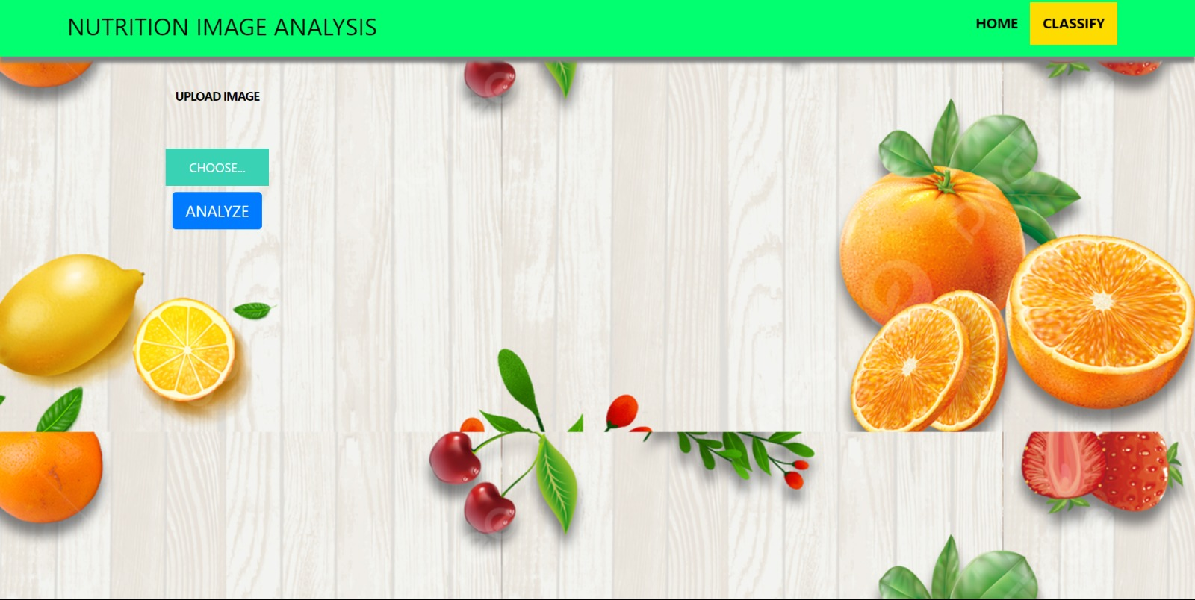
Output
Classification Page

Slide 13
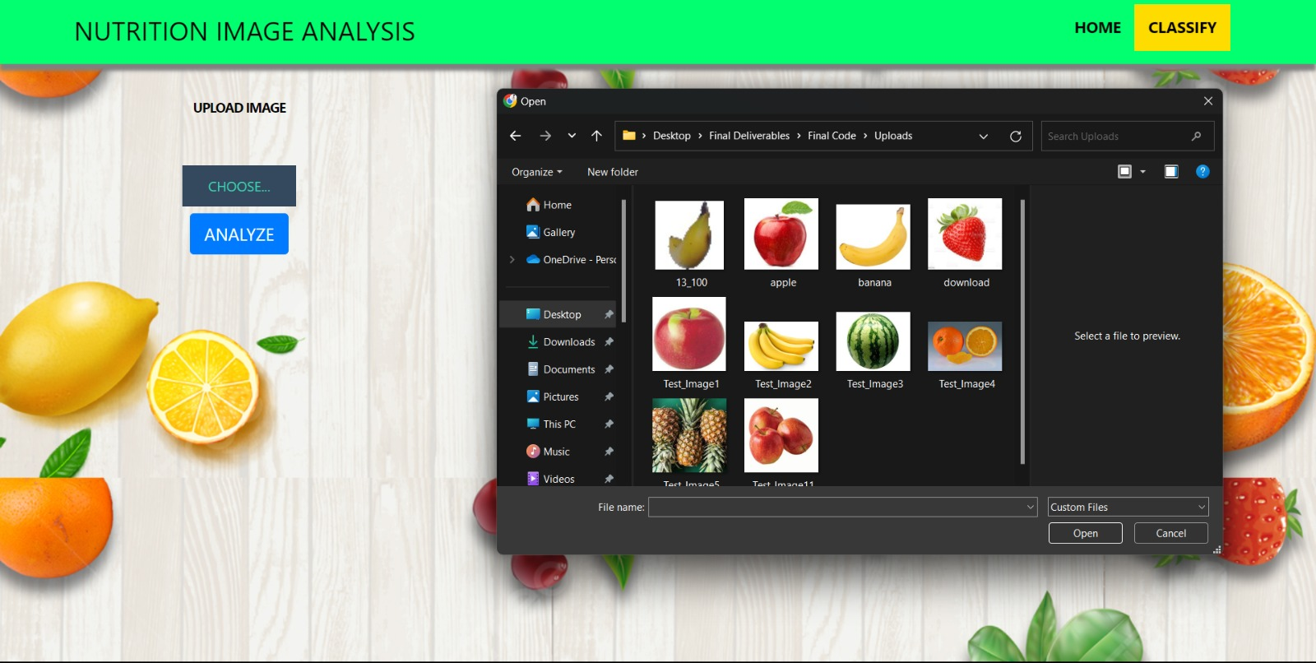
Output
Choose an image to analyze

Slide 14
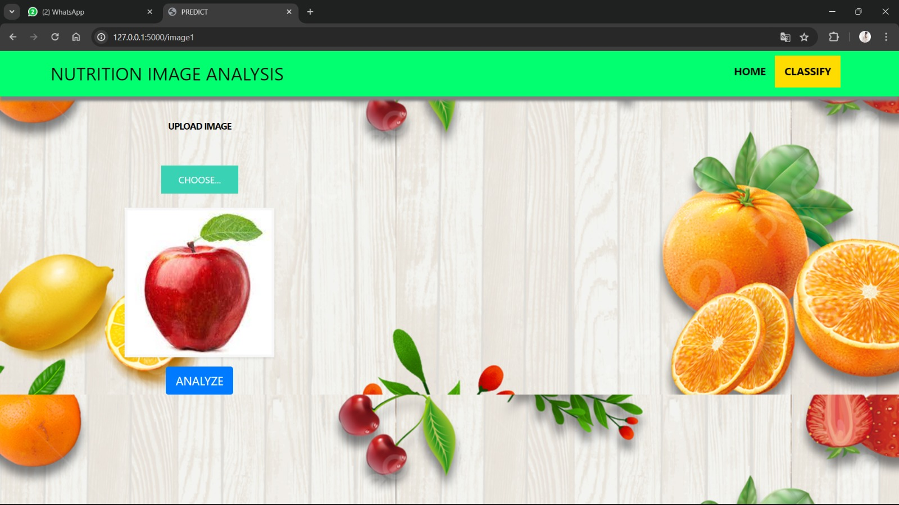
Output
Click analyze button

Slide 15
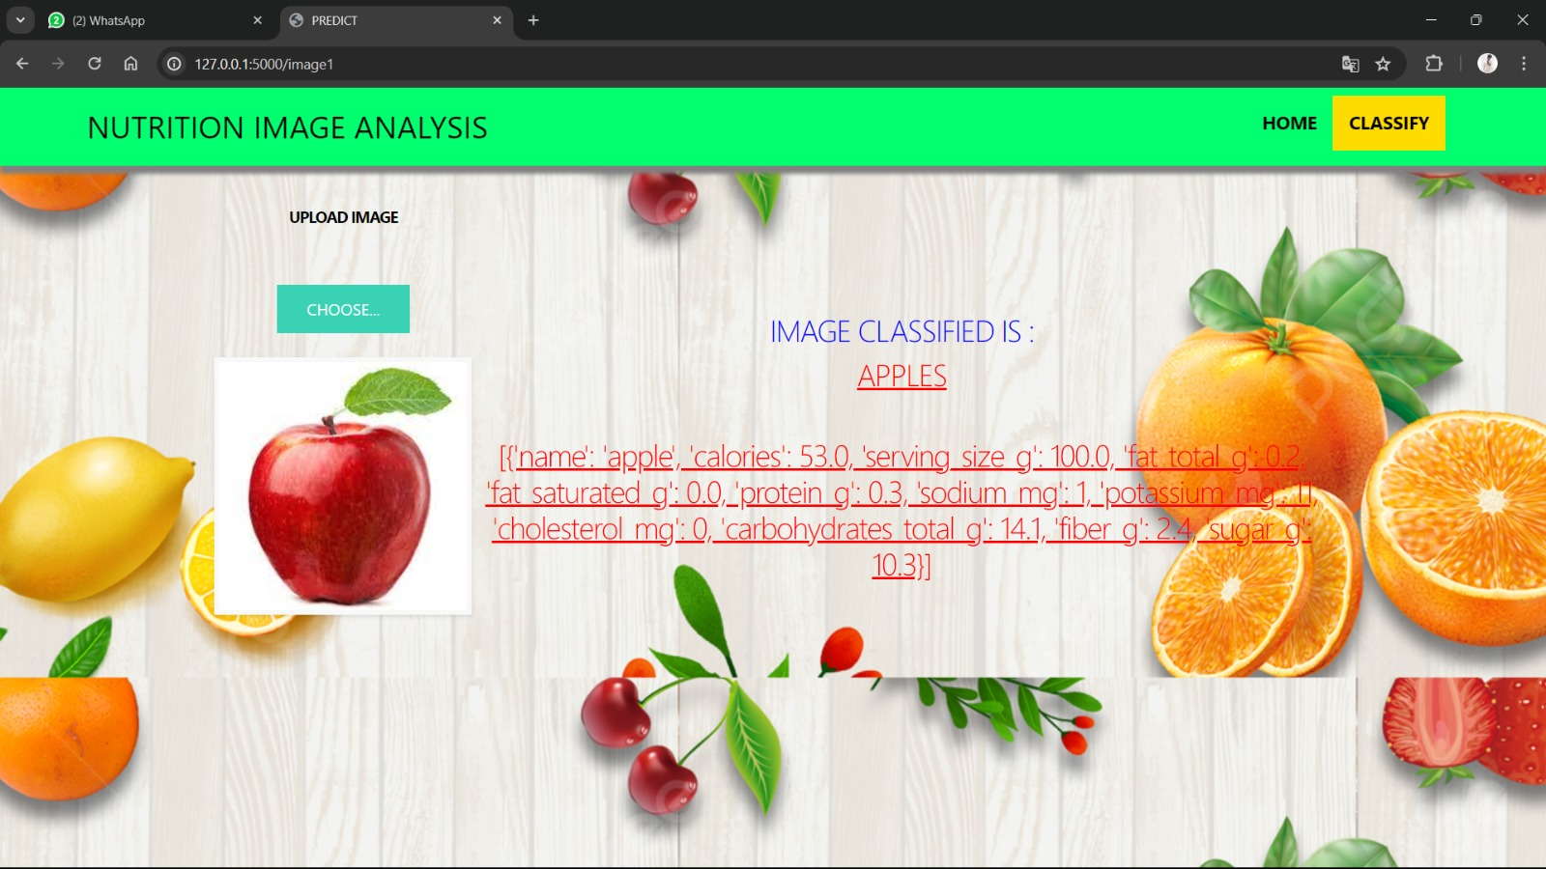
Output
Final output

Slide 16
Conclusion
The development and evaluation of the AI-powered nutrition analyzer have yielded promising results, showcasing its potential to revolutionize personalized nutrition management for fitness enthusiasts. Through advanced machine learning algorithms, natural language processing, and image recognition, the system demonstrated high accuracy in assessing meal nutrition and interpreting user inputs. The intuitive user interface facilitated seamless interaction, while personalized recommendations effectively aligned with user goals, leading to significant improvements in dietary habits and fitness metrics.

Slide 17
References
1. Flask Framework for Python Developer (Book)
2. Data Analytics Using Python (Book)
3. Data Visualization Using Python (Book)
4. https://www.ncbi.nlm.nih.gov/
5. https://www.safetyandquality.gov.au/
6. https://www.covetus.com/blog/
7. https://analytics.google.com/analytics/academy/

Slide 18
Thank You

